Slide 1

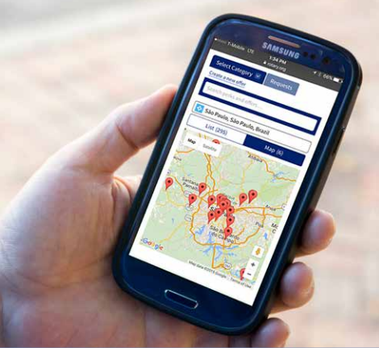

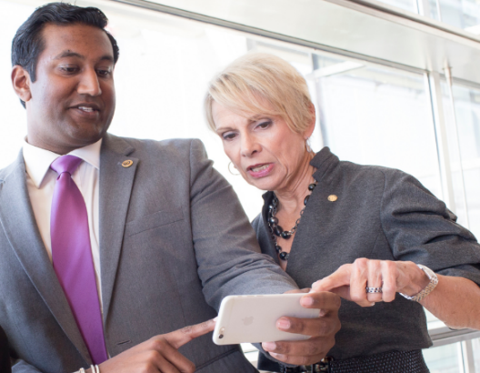

Rotary Global Rewards
OVERVIEW

Slide 2
ABOUT ROTARY GLOBAL REWARDS
Rotary Global Rewards is the member benefits program designed exclusively for Rotarians
    Discounts on over 1,800 products and services
    Offers from 700 Rotarian businesses worldwide
    Ways to give back to Rotary
    The opportunity to post your own offers
    A connection to local businesses
Notes:
Rotary Global Rewards is an exclusive member benefits program that offers Rotarians, Rotaractors, and alumni discounts on products and services and ways to give back to Rotary through their purchases. Members can also post their own offers and encourage local businesses to participate.
The Rewards program now has more than 1,800 offers, including offers from 800 Rotarian-owned businesses. The most popular categories are travel, shopping, entertainment, dining, and services.

Slide 3
















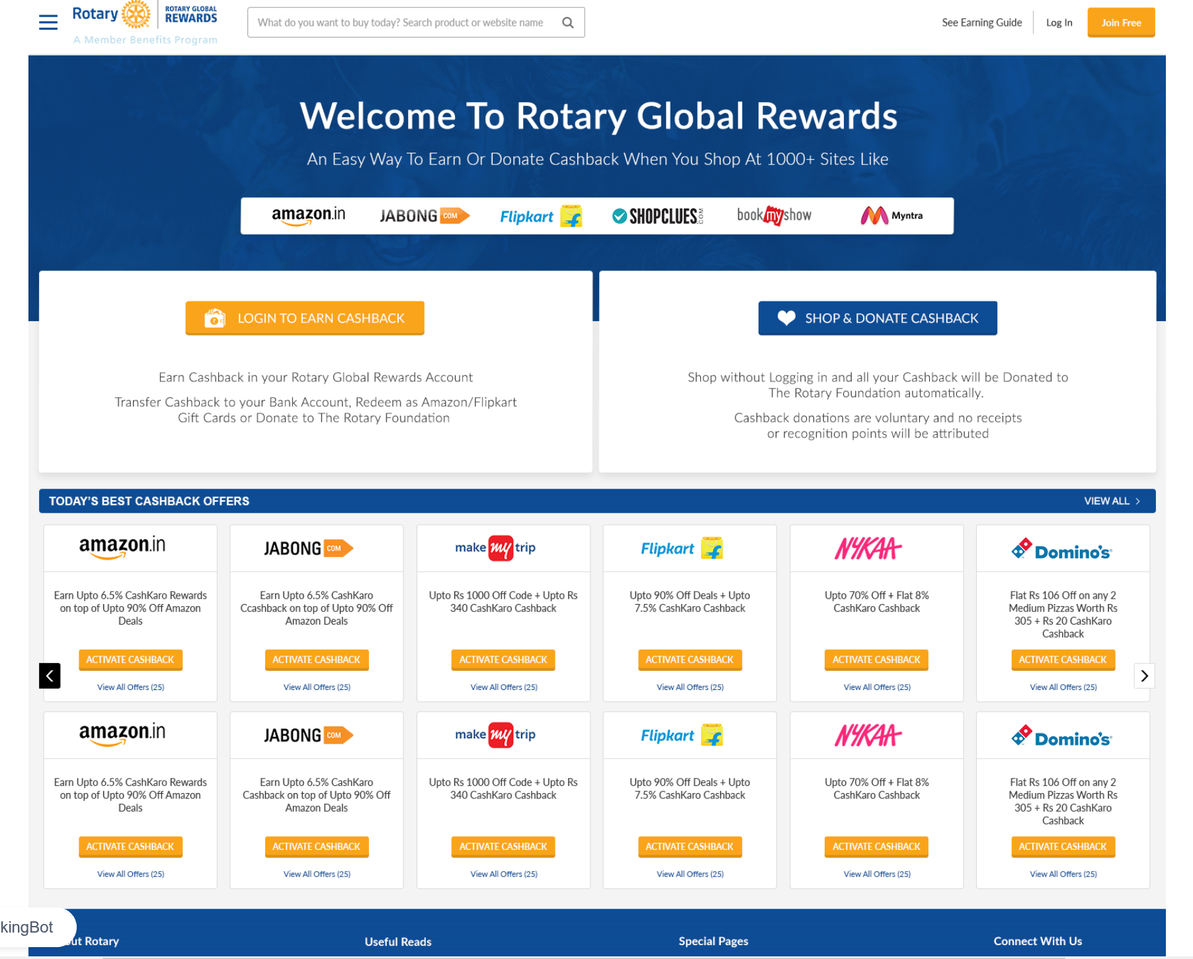

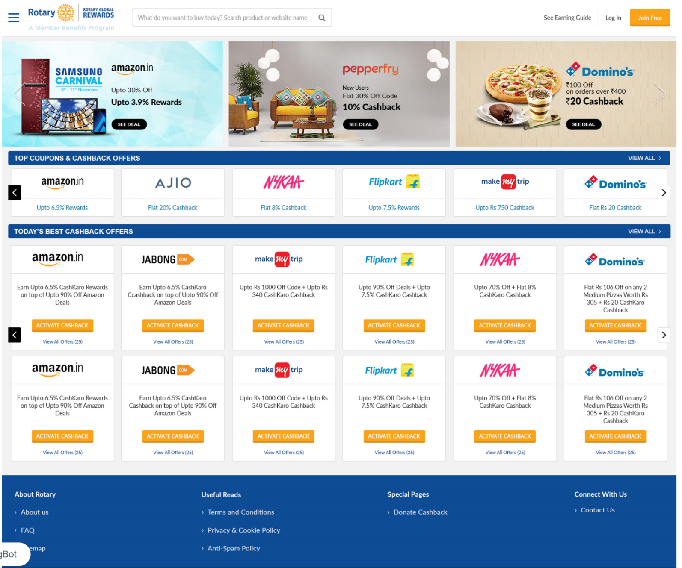
COMPANIES THAT OFFER DISCOUNTS
Notes:
[NOTE: Or simply mention deals that you’ve seen on Rotary Global Rewards that you think would appeal to your audience.]
Here are some of the companies around the world that offer discounts through Rotary Global Rewards:
In the U.S., Bank of America credit card, Office Depot/OfficeMax, UPS, and Walmart
In Brazil, Americanas stores and CVC tour operators
In Australia, Harvey Norman
In India, Jet Airways
In Korea, Kyobo Book Centre
In Japan, ORIX Rent-a-Car
And in most parts of the world, Amazon
Worldwide, you can use Hertz, the Hotel Discount Center, and the Airline Discount Center to book car rentals, hotels, and flights at discounted rates. Check Rotary Global Rewards each time you travel to see what offers are available at your destination.

Slide 4
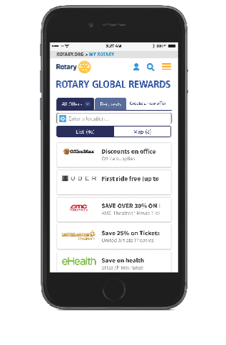
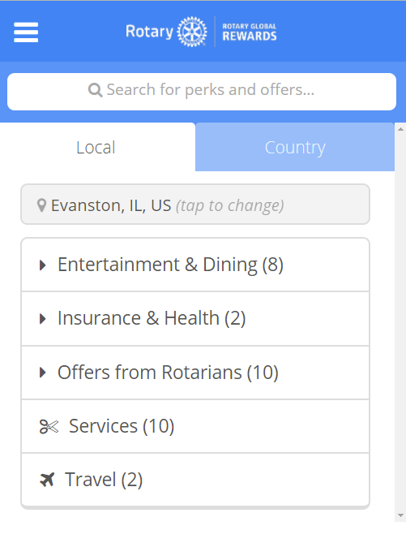
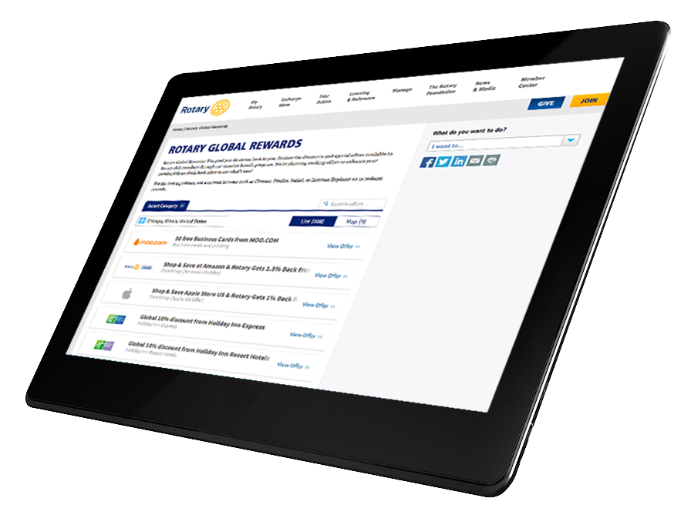
ROTARY GLOBAL REWARDS IS EASY TO USE
Rotary Global Rewards is available to all Rotary and Rotaract members and program alumni!

Slide 5
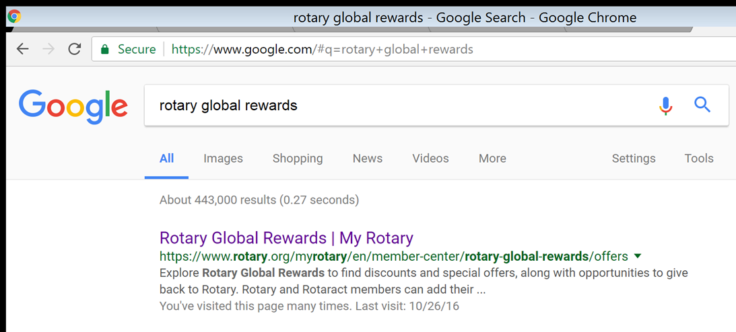
OPEN IT FROM YOUR BROWSER
Go to rotary.org/globalrewards
or search for “Rotary Global Rewards”

Slide 6

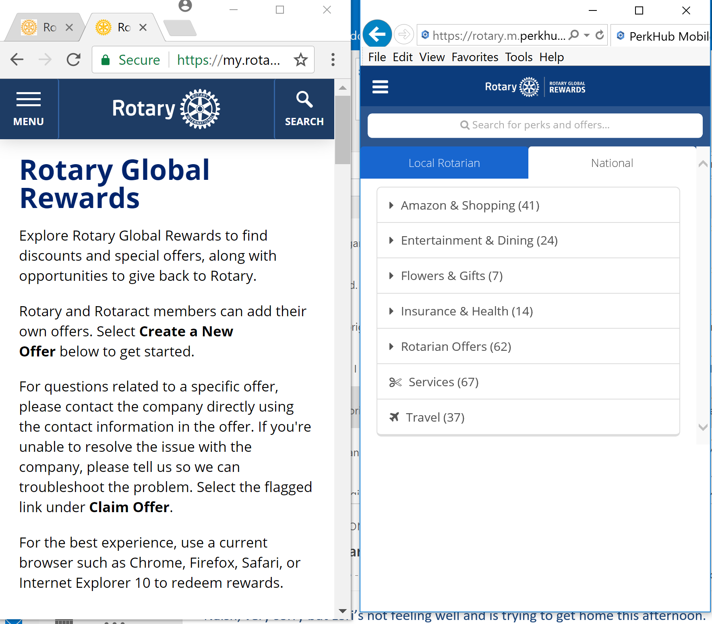


USE YOUR SMARTPHONE OR TABLET
Download the Rotary Global Rewards app

Slide 7
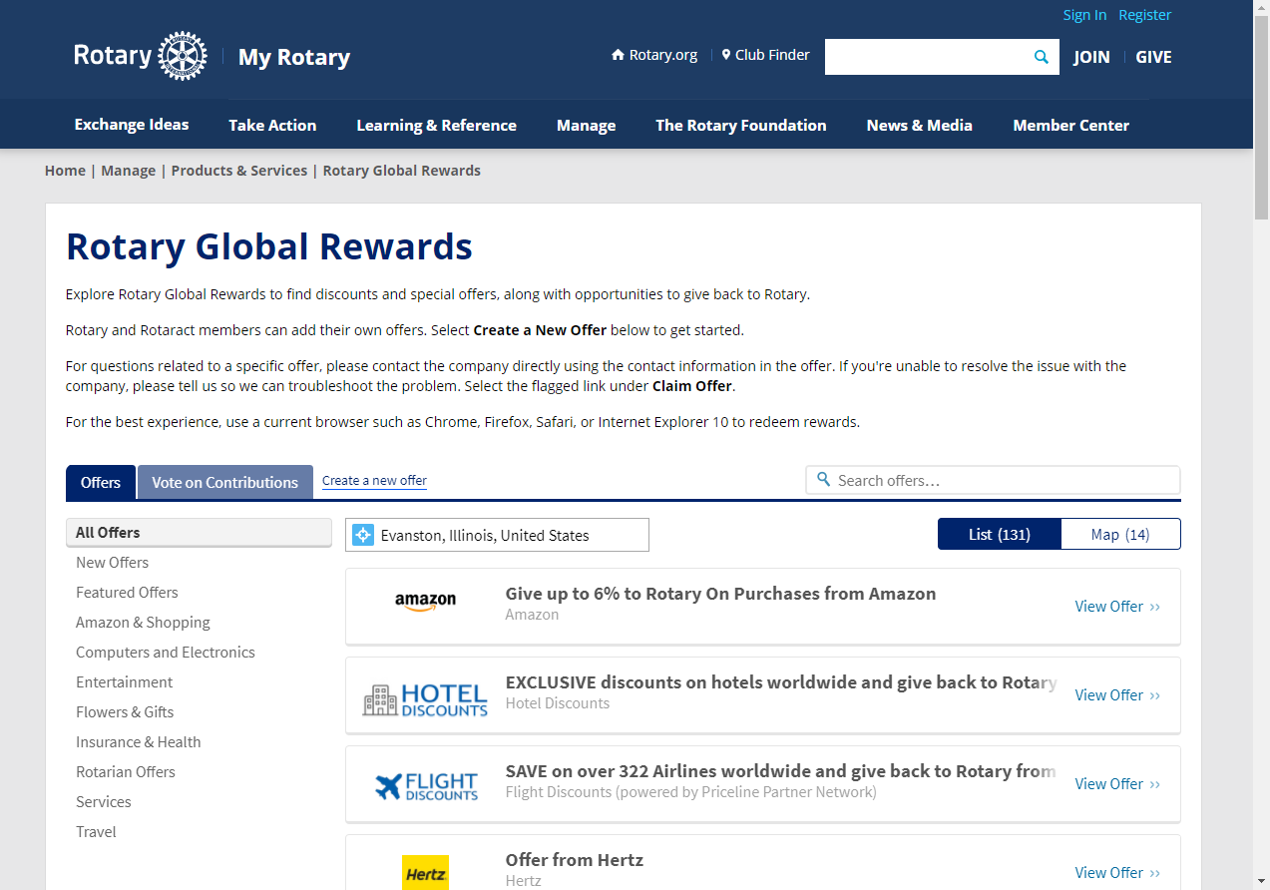
HOW TO USE IT
Learn how to:
Search for offers
Post your own offer
Notes:
Next we’ll show you how to get to Rotary Global Rewards, search for deals, and post your own offer. [Note you can also show a live demonstration after this slide.]

Slide 8
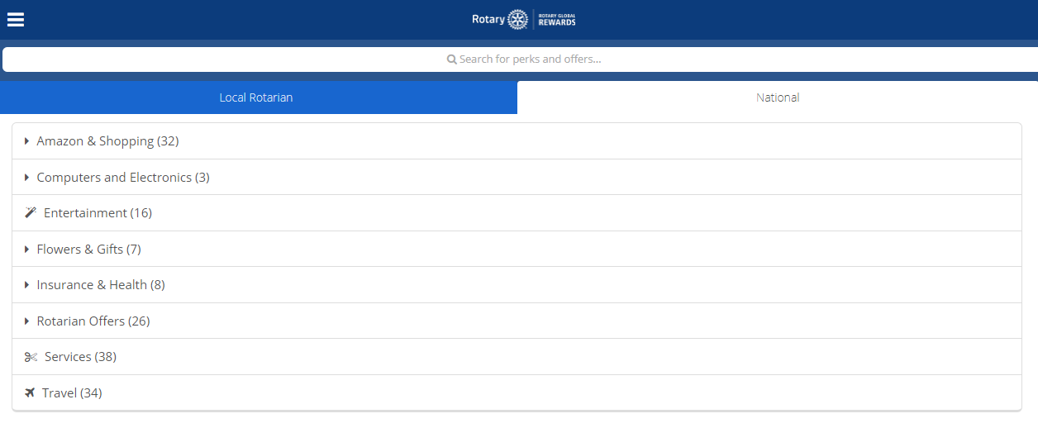
HOW TO FIND NATIONAL OFFERS
OPTION 2: search for specific offers
OPTION 1:
find offers by category
Notes:
You can search for national offers by category or search for a specific offer in the search bar.

Slide 9
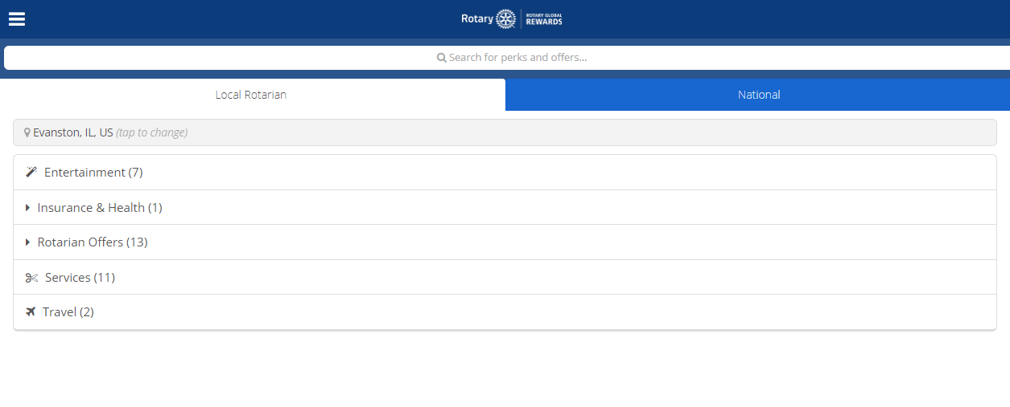
HOW TO FIND LOCAL OFFERS FROM ROTARIANS
OPTION 3:
find offers by location
OPTION 2: search for specific offers
OPTION 1:
find offers by category
Notes:
You can search for local offers by category, location, or search for specific offer in the search bar.

Slide 10
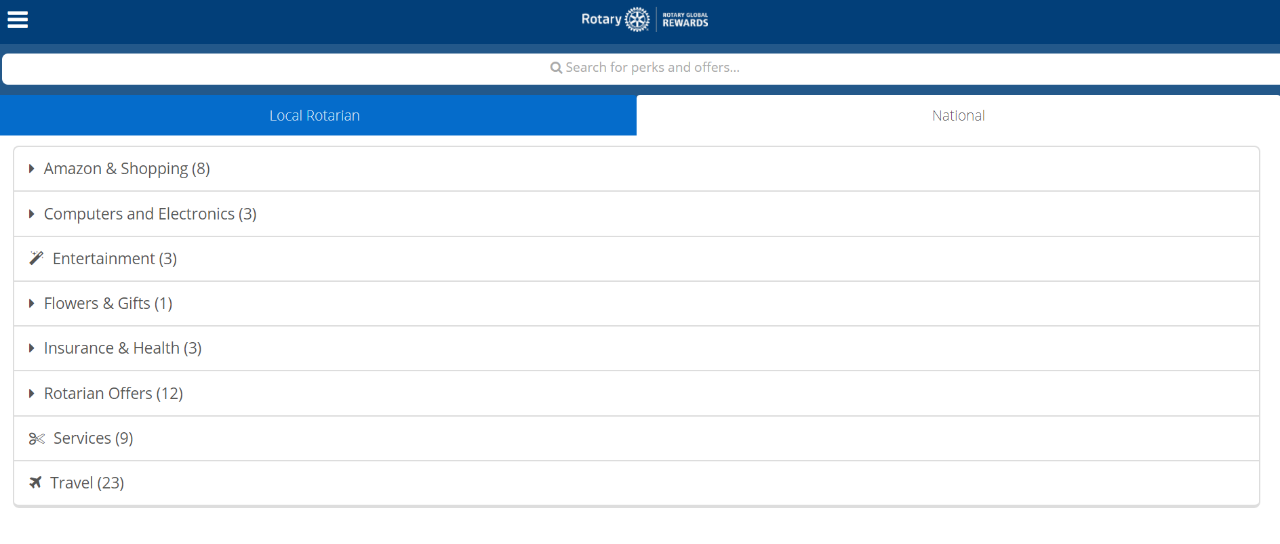
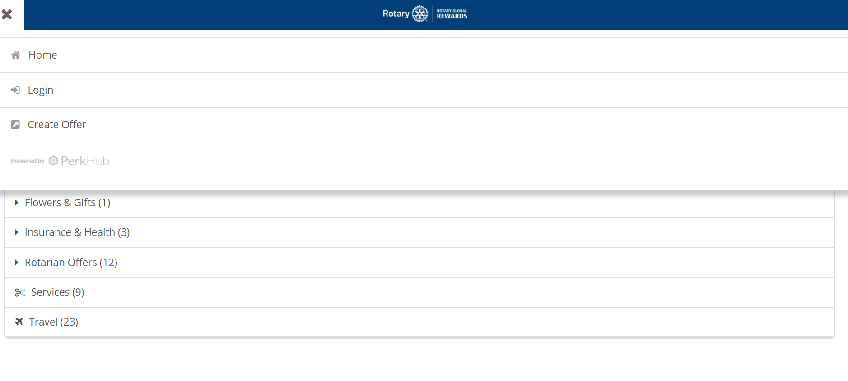
HOW TO POST AN OFFER
Step 1:
Go to the menu
in the upper left
Step 2:
Choose “Create Offer”
Notes:
To post your own offer, just open the menu in the upper left corner and choose “Create Offer”.

Slide 11
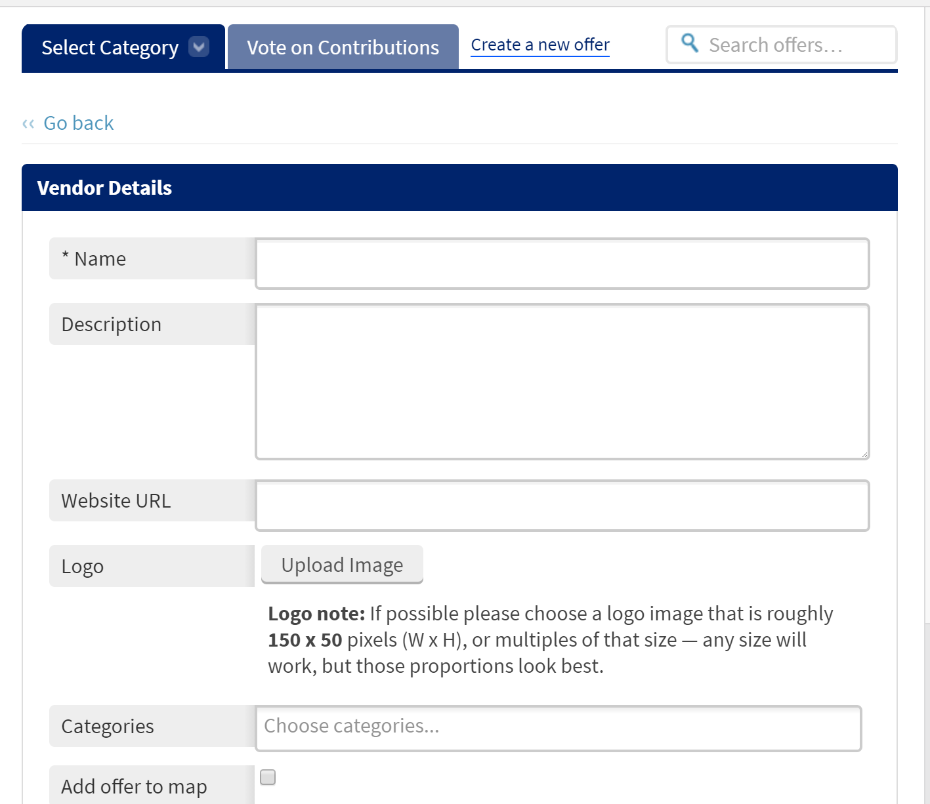
HOW TO CREATE AN OFFER
COMPLETE THESE FIELDS TO POST
YOUR OFFER
Notes:
To create an offer, just fill out the form and agree to the terms and conditions. Offer submissions take 1-2 business weeks to review.

Slide 12

PROMOTE ROTARY GLOBAL REWARDS
    Download the Rotary Global Rewards app.
    Add a Rewards link on club websites and Facebook pages.
    Use the promotional kit available on the Rotary Global Rewards page.
    Email club members about local offers.
    Encourage local Rotarians to advertise their businesses and post their own offers.
          Use Rotary Global Rewards for club purchases.
rotary.org/globalrewards
Notes:
Make sure club members and local businesses take advantage of all the opportunities available through Rotary Global Rewards.
Here are some ways you can promote Rotary Global Rewards:
First, download the Rotary Global Rewards app from the Apple App Store or Google Play. And encourage other members to do the same.
Add a link to Rotary Global Rewards on your club website and Facebook pages. Link to rotary.org/globalrewards.
Use the promotional materials, including videos, with your club. Find them at the bottom of the Rotary Global Rewards page, under Resources & Reference.
Email club members to encourage them to try the program. Highlight local businesses that participate.
Invite local Rotarians to advertise their businesses by posting offers.
Remember to use offers from participating businesses (including Amazon, Office Depot OfficeMax, and FedEx) when you make purchases for your club and its service projects.

Slide 13
Questions about
Rotary Global Rewards?
rotaryglobalrewards@rotary.org
We’d love to hear from you!
Email us your questions and comments.
Notes:
Rotary wants to hear from you. Tell them what types of deals you’d like to see on Rotary Global Rewards. They’re always looking for new ways to improve their offerings.

