Slide 1
THE ROTARY FOUNDATION
& THE MILLION DOLLAR DINNER
Notes:
Charitable arm of Rotary

Slide 2

In 1917, Arch C. Klumph proposed that an endowment be set up “for the purpose of doing good in the world.”
Notes:
The Rotary Foundation was created nearly 100 years ago. The Foundation started with $26.50 and today the Annual Program Funds receives over $120 million each year and our endowment fund is approaching $1 Billion. This is a brilliant achievement.

Slide 3

Rotary Foundation’s Mission
To enable Rotarians to advance world understanding, goodwill, and peace through the improvement of health, the support of education, and the alleviation of poverty.

Slide 4




ROTARY FOUNDATION AWARDS
Rates financial performance, accountability, transparency
11 consecutive highest 4-star ratings
Score 100

Slide 5
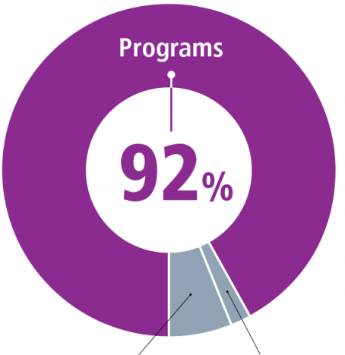
HOW IS THE MONEY SPENT?
91%
Fundraising
6%
Administration
3%

Slide 6
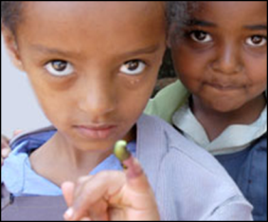
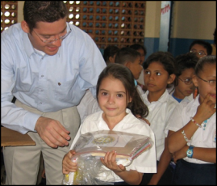
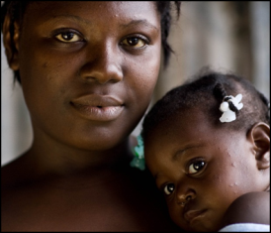
YOUR CHOICES WHEN SUPPORTING THE ROTARY FOUNDATION
PolioPlus Fund
End Polio Now
Annual Fund
For Support Today
Endowment Fund
To Secure Tomorrow
Notes:
PolioPlus Fund, dedicated to global polio eradication
Need to continue immunizing 3 years after no cases
2017 14 cases, 2018 so far Pakistan 1, Afghanistan 7, Nigeria 0
2017-2020, every $1 donated (up to $50 million per year) will be matched by an additional $2 from the Gates Foundation.
Since 1985 immunized 2.5 billion children in 122 countries
Annual Fund, the primary source of funding for Foundation grants and activities
Supports local and international grants through the SHARE system
Contributions are credited to the donor’s club and applied to the club’s goal
Endowment Fund, which supports the Foundation in perpetuity Large donations
Contributions are professionally invested, only earnings are spent

Slide 7
D7080 PROJECTS SINCE 2013
 | # of Projects | 7080 Club & District Contributions | Total Funding
Global Grants (in progress or closed) | 26 | $917,765 | $2,130,896
District Grants | 76 |  | $264,803
Notes:
$US
Another $438,000 GG waiting for approval

Slide 8
MILLION DOLLAR DINNER
Notes:
Charitable arm of Rotary

Slide 9
WHAT IS A MILLION DOLLAR DINNER?
Raise US$1 Million for The Rotary Foundation
New donations
Celebration of a 9-12 month campaign
Major Gifts & Bequests of US$10,000 or more
District sponsored event – with TRF support
Notes:
The Rotary Foundation Canada
Share comes back to Distric=

Slide 10
WHY HOST A MILLION DOLLAR DINNER?
Raise awareness of the Foundation
Raise new money for the Foundation
Bequests / Cash gifts of US$10,000 +
3 year pledge of US$10,000 +
Term gifts – area of focus $15,000 to $30,000
Gifts of insurance – discuss first
Named Funds US$25,000 +
Notes:
Term gifts – can support a project, money to be used immediately.

Slide 11
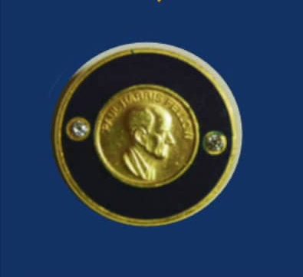

BEQUEST SOCIETY
Provision in estate plan totaling $10,000+ USD
Examples: will, life insurance policy
Notes:
The Rotary Foundation Canada
Share comes back to District

Slide 12
Named Funds
$25,000
Support World Fund or SHARE or Peace Centers
$100,000
Support an Area of Focus
$250,000
Support Area of Focus projects in a district
$500,000
Establish an Endowed Rotary World Peace Fellowship
$1,000,000
Work with TRF to meet your philanthropic goals
$750,000
Endows a two-year fellow every
3 years
Notes:
Special opportunities exist to create a custom fund within the Endowment Fund. A fund can carry the name of the donor or loved one — and is tracked separately. Donors receive an annual update on their endowed fund.
Named funds are gifts of $25,000 or greater. You can support your district with a gift designated to SHARE or the Peace Centers. A gift of $500,000 can support a Rotary Peace Fellow every four years. Gifts can be designated to one of the six areas of focus.
Named funds can be a special way to remember a family member or leave a personal legacy.

Slide 13
Ways to give or pledge:
  Will - Codicil
  Life Insurance
  Cash
  Property
  Registered Funds
  Securities

Slide 14
Easy as 1, 2, 3
Notes:
Download and complete the Bequest/Donation Form
Email, scan, fax, mail your form to RI via Carolyn Ferguson, our Major Gift staff member for Zone 24
Update your will

Slide 15
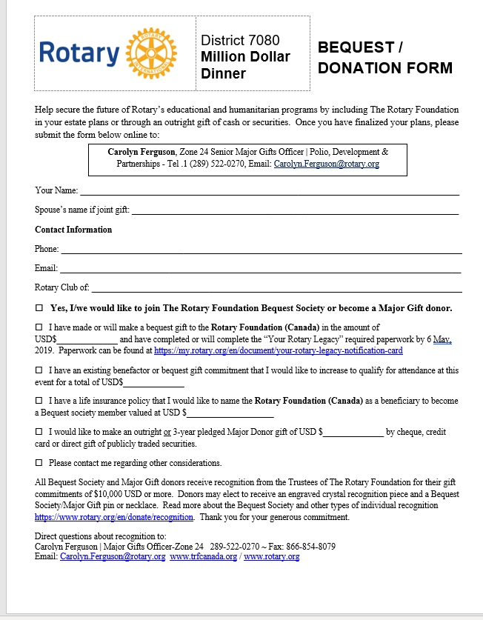
How Do I Sign Up?
1. https://rotary7080.org
Click ‘Million Dollar Dinner’
2. Download Bequest/
Donation Form
3. Complete and send to RI

Slide 16
Questions

