Slide 1
Managing membership leads
[Presenter name]
[Date]
Notes:
NOTE TO SPEAKER: This presentation uses screen shots to show how to use the Manage Membership Leads page on My Rotary. If you have access to the internet, we recommend using your own leads page or the Practice Lab to demonstrate how these processes work.
Welcome everyone! Thank you for joining us today to learn how to take advantage of an effective but often underused recruitment process: your Manage Membership Leads page on My Rotary.
During this presentation, we’ll look at the value of using Membership Leads to find new members, show you how to manage and admit candidates, and give you some tips for communicating with prospective members.

Slide 2



Where do membership leads come from?
Prospective
members
Relocating or returning members
Member
referrals
Notes:
Leads come to us in three ways:
Prospective members submit the online form at rotary.org/join. The form asks for some basic information, like their profession, club meeting preferences, and how best to contact them.
Relocating or returning members use the REJOIN OR CHANGE CLUBS button in the Member Center on My Rotary.
Rotarians use the REFER A MEMBER button in the Member Center to refer someone they know who would make a good Rotarian.
Staff members, in deciding which district should receive the lead, consider the person’s club meeting preferences or location, Profession, and any comments provided.
You can tell whether a person will make a good Rotary member only by getting to know them. Using Membership Leads doesn’t replace personal contact. It just makes it easy for club and district leaders to receive and act on leads and keep track of potential members.

Slide 3






The path to membership
District reviews information and matches candidate with a club
Club contacts candidate and establishes a relationship
Club invites candidate to join and updates status
Notes:
We’ll go into detail about the path to membership later, but here’s an overview.
District leaders are notified that a member lead has been assigned to the district. They use the Manage Membership leads page to review the candidate’s form and assign the lead to the club that best suits the person’s needs. They consider the potential member’s preferred meeting time, club environment, and location.
Club leaders are notified by email that a new lead is waiting. After reviewing the candidate’s information on the Manage Membership Leads page, the club contacts the lead and invites them to visit the club. If it’s a good match for both the club and the candidate, the club invites the candidate to join.
If the candidate accepts, club leaders can use the Manage Membership Leads page to admit the new member. If the club or the candidate decides that the match isn’t a good fit, the club can ask the district to assign the lead to another club.

Slide 4

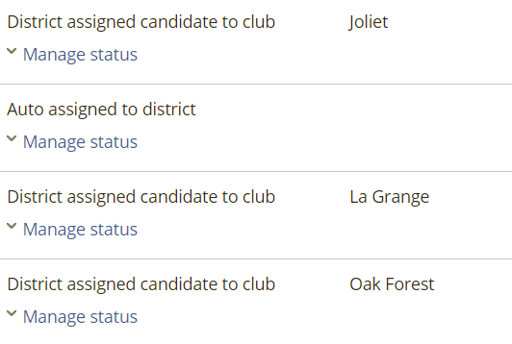
The advantage of USING membership leads
Notes:
When you follow your membership leads, you can track a prospective member’s progress from expressing interest to becoming a member.
You can always see the lead’s status on the Manage Membership Leads page. Club and district leaders can see when a lead was contacted, invited to a meeting, or proposed for membership. They can also find and leave comments about a candidate and their progress.

Slide 5
WHO CAN MANAGE LEADS: In a DISTRICT
Role (if reported to Rotary International) | Receives email | Can manage (update status, admit) | Can view
District governor | X | X | X
Assistant governors | X | X | X
District membership chair | X | X | X
Executive secretary | X | X | X
Other current district officers |  | X | X
Officers-elect |  |  | X
Immediate past officers |  |  | X
Notes:
This chart shows who in the district can view and manage its leads. When Rotary receives a membership inquiry, a staff member assigns the candidate to a district. An email is sent to the district governor, all assistant governors, the district membership chair, and the executive secretary, if one was reported to Rotary. They and all other current district officers can update the lead’s status through the Manage Membership Leads page. Officers-elect and past officers can view the district’s leads.

Slide 6
WHO CAN MANAGE LEADS: IN A CLUB
Role (if reported to Rotary International) | Receives email | Can manage (update status, admit) | Can view
President | X | X | X
Membership chair | X | X | X
Secretary | X | X | X
Executive secretary | X | X | X
Other current officers |  | X
Club’s assistant governor | X |  | X
Officers-elect |  |  | X
Immediate past officers |  |  | X
Notes:
In a club, the president, membership chair, secretary, and executive secretary have the most access. They receive an email notification when the district has assigned a lead to their club. They can update leads’ status, make notes, admit prospective members to membership, and run reports, all from the Manage Membership Leads page. It’s important to note that, if officers aren’t reported to Rotary, they can’t do these things.
Other club officers reported to Rotary (such as the club treasurer) can also manage leads. Immediate past and future officers can view leads.

Slide 7
Who are these prospective members?
 | MEMBERSHIP LEADS | CURRENT MEMBERS
Under 40 | 63% | 5%
Women | 35% | 21%
50% hear about Rotary through
a personal connection
Notes:
Of the people who ask to join a Rotary club:
63% are under 40
35% are women
How do these numbers compare with current Rotary membership?
5% of Rotarians are under 40
21% are women
Half of the potential members indicate that they heard about Rotary through a personal connection. Engaging with them offers your club a real opportunity to diversify and better reflect the community you serve.

Slide 8
WHEN MEMBERSHIP LEADS ARE NEGLECTED
OF THE 17,898 ASSIGNED TO DISTRICTS:
Never contacted by the district | 62%
Never assigned to a club | 77%
OF THE 4,131 ASSIGNED TO CLUBS:
Never contacted by the club | 67%
54% no longer interested in Rotary
Notes:
Last year, Rotary districts received almost 18,000 membership leads that involved prospective, referred, or relocating members. But only 793 were admitted to clubs through the Manage Membership Leads page.
It may be that some districts or clubs have a separate system for managing membership inquiries, we also know that many of these prospective members are never contacted. Based on membership leads reports, clubs contact only a third of the prospective members assigned to them.
When we don’t respond to leads, we not only miss opportunities to grow our clubs, we also miss a chance to create goodwill in the community. Of the candidates who don’t hear back from us, 54 percent say they’re no longer interested in Rotary.
One prospective member wrote: “To my great disappointment, no one from Rotary contacted me. So I ended up joining Kiwanis.”

Slide 9
How you can help
1. Respond to all inquiries, even old ones.
Assign leads to clubs you know
will respond.
Notes:
With so many potential members, it’s more important than ever that clubs and districts understand the advantages of following up on their membership leads.
It’s never too late to begin managing your leads (and repairing any public relations damage that may have come from overlooking potential candidates). Here’s how:
Respond to all inquiries, even very old ones. It never hurts to ask if a person is still interested in learning about Rotary.
Assign leads to clubs that you know will respond. If a club habitually ignores your referrals, contact the club leaders directly and encourage them to respond to the candidate in whatever way works best for them.

Slide 10
HOW ROTARY helps with MEMBERSHIP LEADS
Reviews leads and assigns them to district leaders
Reminds district and club leaders to take action on older leads
Responds to candidates who write with questions or concerns
Reconciles duplicate records
Notes:
Only district and club leaders can determine if a candidate will make a good Rotarian. But it’s important to understand Rotary’s role in helping members manage leads.
Rotary staff, on average, sends 1,500 membership inquires per month to districts worldwide. In addition, staff members:
Send reminder messages to district leaders regarding old or aging leads
Respond to inquiries from candidates who wonder why they’ve never been contacted and what their other options are; usually, we use Club Finder to find a club in their area and encourage the candidate to contact it directly
If members are being admitted through a different process and any records are duplicated, Rotary can also reconcile those records to correct your club data.

Slide 11
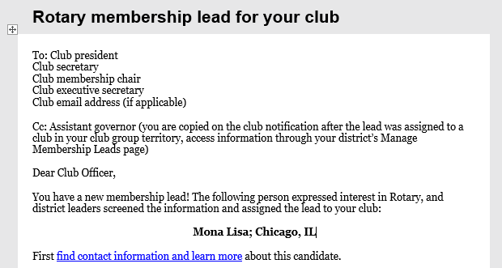
EMAIL NOTIFICATION OF MEMBERSHIP LEAD
Notes:
How will you know if you have a lead? You’ll receive an email with the subject “Rotary membership lead for your club.” The link in the message will take you to the Manage Membership Leads page, where you can find information about your candidate.

Slide 12
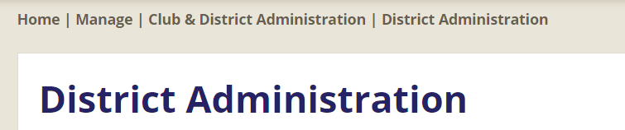
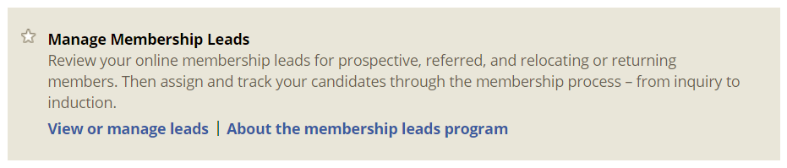
YOUR Manage MEMBERSHIP LEADS PAGE
Notes:
How else can you find your leads?
You can check, update, or admit leads anytime. Sign in to My Rotary. Under the Manage menu, select Club Administration or District Administration, Then “Manage My Club /District.” On that page Scroll to the Manage Membership Leads section.

Slide 13
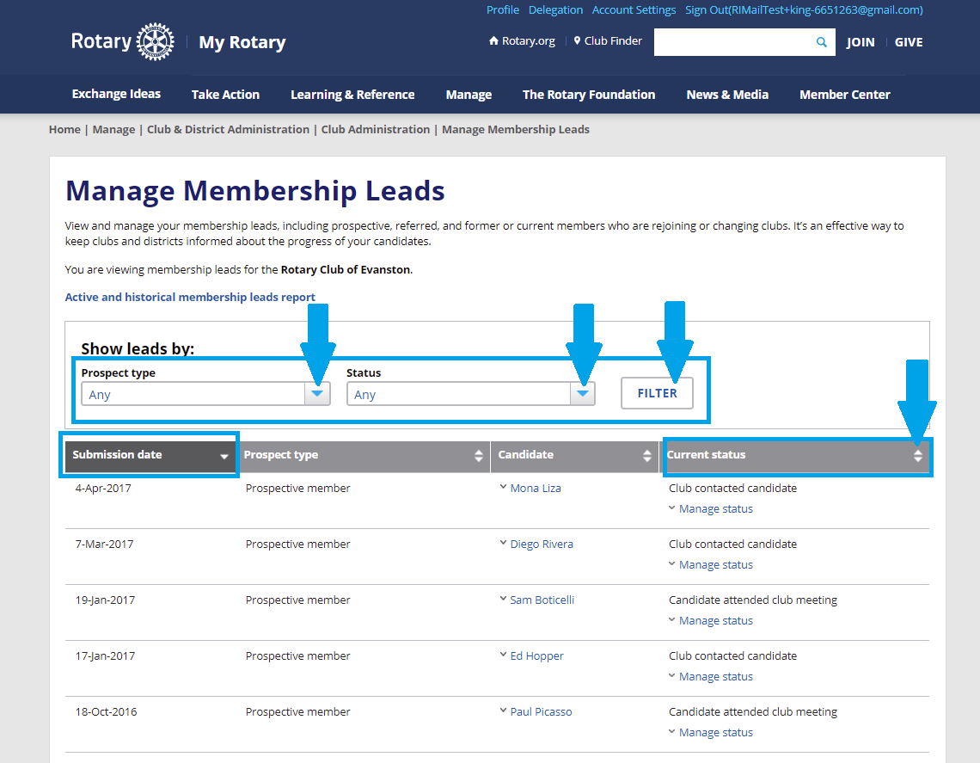
Filter and sort
Notes:
Sort by submission date to see the leads that were most recently assigned to your club or district. You can also use the down arrow to see older leads and their status.

Slide 14
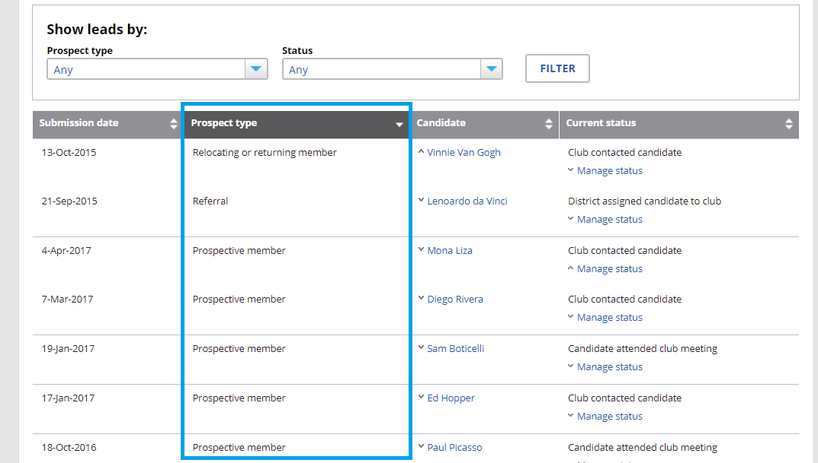
TYPES OF CANDIDATES
Notes:
You can also sort by prospect type: relocating or returning member, referral, or prospective member.

Slide 15

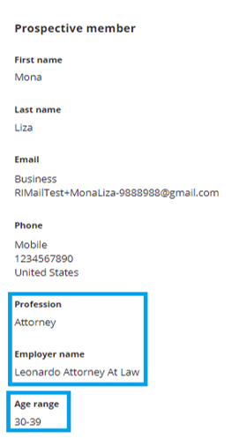
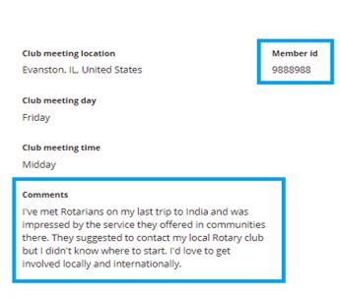
Inside a record
Notes:
When you click on the lead’s name, you’ll see the person’s profession, age range, gender, contact information (email address and phone numbers), preferred meeting location and time, and comments.
The Rotary ID is a tracking number that is assigned to the lead. If a lead eventually becomes a Rotary member, it will become their member ID. If you use a third-party system, such as DacDB or ClubRunner, to track your leads, be sure to use the same ID so that you don’t create a duplicate record. This also saves you time because you won’t have to enter information Rotary already has.

Slide 16
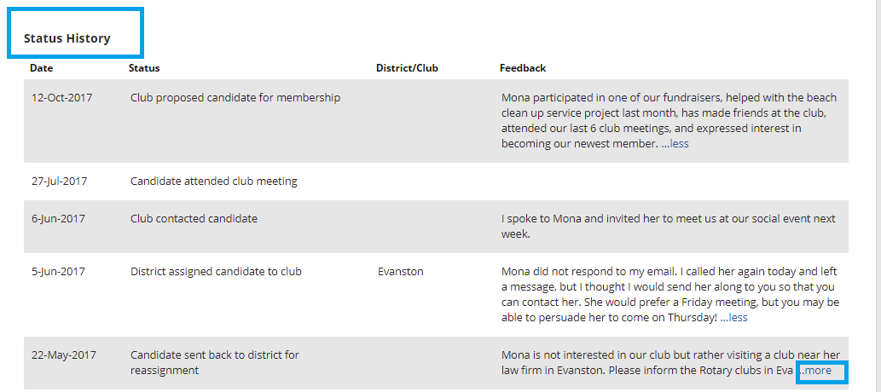
STATUS HISTORY
Notes:
Here’s an example of a prospective member’s progress through the membership leads process — from being assigned to the district to eventually being proposed for membership.

Slide 17
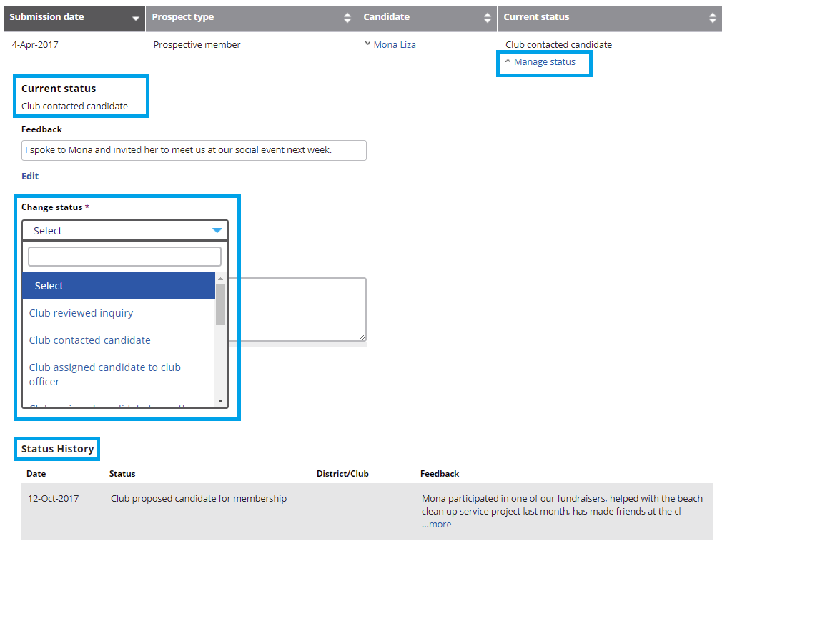
MANAGING A STATUS
Notes:
And here’s how each status change was noted. When you’re ready to update the status of a lead, use the menu under Change Status. It has many options for both club and district users, as you’ll see in the next slide.

Slide 18
STATUS OPTIONS | DISTRICT | CLUB
Reviewed inquiry | X | X
Contacted candidate | X | X
Assigned to district or club officer | X | X
Sent back for reassignment* | X | X
Determined candidate not interested in club or Rotary* | X | X
Assigned candidate to club | X
Attended club meeting |  | X
Proposed for membership |  | X
Admitted to club* |  | X
*These options remove a lead from the page
Notes:
Status options include:
Reviewing the inquiry (you can make notes about the candidate’s interests or who should contact the candidate next)
Contacting the candidate (you can make notes about the conversation or your next steps)
Assigning a prospective member to another officer (this is a great option to use if other leaders, like assistant governors, are helping you follow up with a lead)
Reassigning the candidate to the district or determining that the candidate is not interested in your club or Rotary
Assigning the candidate to a club (when a district leader selects this status, a list of all available clubs appears, and the leader can select the one they think would be the best fit)
Clubs can also indicate that:
A candidate has visited the club for the first time
A candidate is proposed for membership, letting the district leaders know they may soon become a new member.
A candidate has been admitted to the club
Any lead that is removed from your active leads page will still be visible in your membership leads reports. These reports are available to club and district officers and summarize what has happened to each lead assigned to a club.

Slide 19
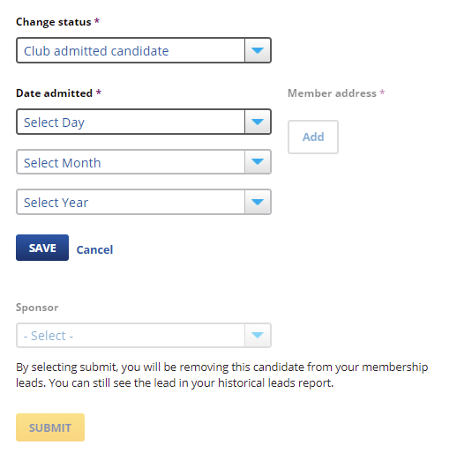
Admitting a CANDIDATE
Notes:
Clubs can admit candidates directly through their Manage Membership Leads page by changing the their status to “Club admitted candidate” and reporting some basic demographic information.
If your club admits candidates this way, your district and Rotary will know that the candidate has joined a club, and the lead will be removed from both the club’s and the district’s Manage Membership Leads pages.
Keep club and district officers informed about your membership leads by reporting changes in their status promptly. This prevents leaders from approaching candidates with incorrect information in mind, for example, talking to a candidate about joining a club that has already been determined not to be a good fit.

Slide 20
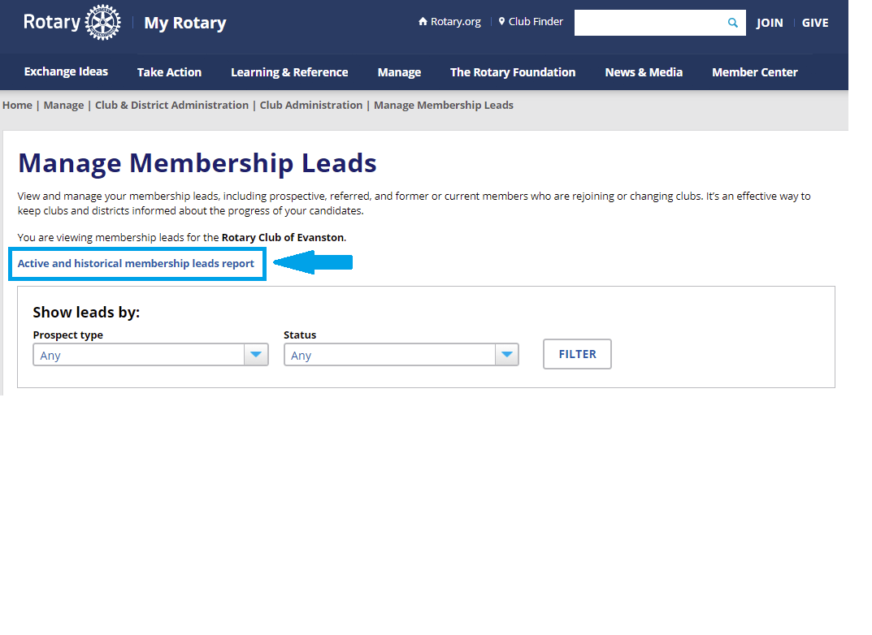
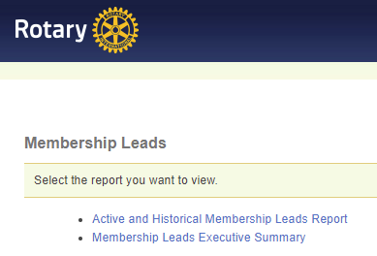
VIEWING CURRENT AND PAST LEADS
Notes:
At the top of the Manage Membership Leads page is a link that club and district officers can use to view the Active and Historical Membership Leads Report, which shows all leads that are currently assigned and any leads that are no longer active.

Slide 21
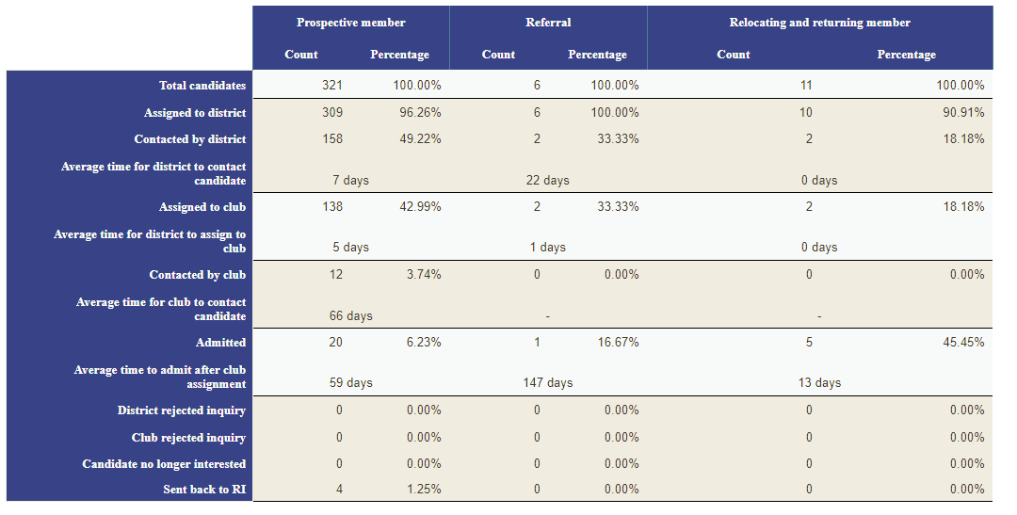
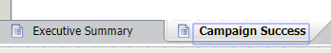
EXECUTIVE summary
Notes:
The Membership Leads Executive Summary lets both clubs and districts see how well the district is managing its leads, including how much time, on average, it takes district leaders to contact candidates, assign them to clubs, and admit them. Other parts of the report show how candidates heard about Rotary and track your media outreach, program, event, and other public relation campaign successes.

Slide 22
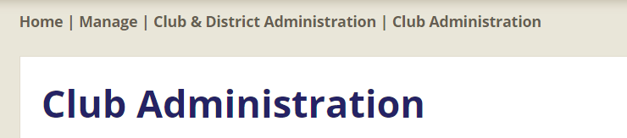
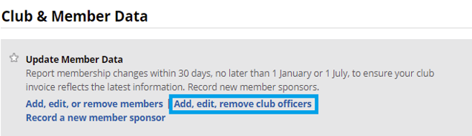
REPORTING OFFICERS
Notes:
Make sure that your club and district membership chairs have access to the Manage Membership Leads pages by adding them through the Club Administration or District Administration page.
For example, under Club & Member Data, select “Add, edit, remove club officers” to report your membership chair to Rotary.

Slide 23
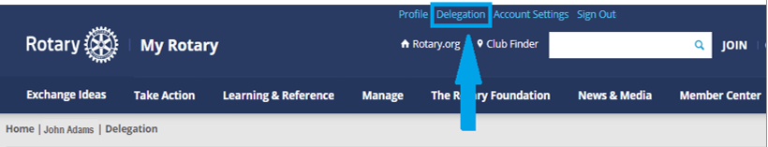
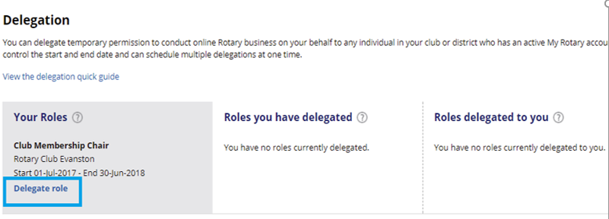
DELEGATION
Notes:
Delegation lets club and district officers authorize others to manage their leads. For example, the club membership chair may want a membership committee member to receive the email notifications about new leads and be the first to contact them. Simply sign in to My Rotary and go to Delegation. Under Your Roles, choose a role and click Delegate role. Indicate who you are delegating your role to and during what time.

Slide 24
Next steps
Tell others about the advantages of managing leads online
Tell your district that your club is looking for leads
Make sure your district leaders know what your club offers candidates
Make a plan for managing leads
Encourage new leads by linking to rotary.org/join on your website and social media pages and including it in brochures and other materials
Notes:
We’ve covered a lot today. I hope you have a better understanding of what using membership leads can do for your club and district. Here are some steps you can take to get the most out of your leads:
Show this presentation to others in your district or club to help them understand the value of using membership leads. Talk about the types of prospective members that may be looking for you.
If you’re a club officer, let your district leaders know that you’re interested in having leads assigned to your club.
Make sure your district leaders have a clear idea of the experience your club can offer candidates. The better district leaders know a club, the more successful they’ll be in assigning candidates that are a good fit.
Make a plan for how you’ll manage your leads. Include who will contact candidates first and who will update the status of leads.
Continue to promote Rotary and encourage people to go to rotary.org/join to ask about joining a club.

Slide 25
QUESTIONS?
  QUESTIONS?
MembershipDevelopment@Rotary.org
Notes:
Thank you for taking the time to learn more about how you can use membership leads.. If you have any questions, please contact [insert email or phone number].

